Slide 1


Slide 2
Jindal Steel & Power
Compreshensive Overview : Exploring Operational insights and strategic growth

Slide 3
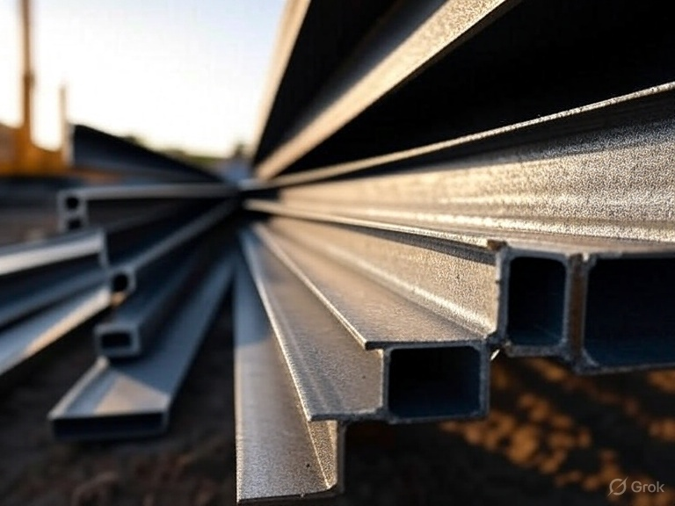
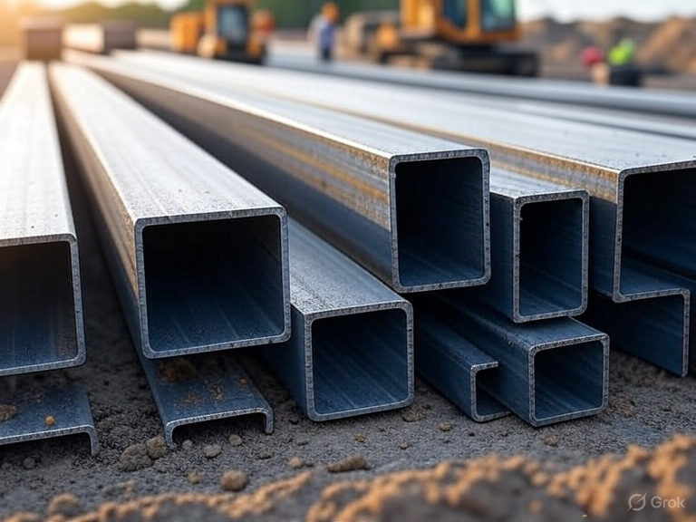
Contents
Introduction to Jindal Steel Company
Key Financial Metrics : Profits and Losses
Operational Sectors of Jindal steel
Year-on Year Financial Performance
Comparison of Domestic vs International Operations
Milestones in Jindal Steel’s Growth
SWOT Analysis of Jindal Steel
PESTEL Analysis of Jindal Steel’s Market Environment

Slide 4
Introduction to Jindal Steel Company
01
02
Company History
Mission Statement
Jindal Steel Company was founded in 1970 by Dr. O.P. Jindal
Our mission is to deliver high-quality steel products that meet global standards.
03
Core values
Integrity, innovation , and sustainability are at the heart of our operations.

Slide 5
Financial highlights of 2023-24
Gross Revenue
₹49,766 crore
Net Profit (PAT)
₹5,943 crore
Adjusted EBITDA
₹10,231 crore
Net Debt
₹11,203 crore

Slide 6
Quarterly Performance Overview
• Revenue: ₹13,487 crore
• Profit After Tax (PAT): ₹933 crore
• Adjusted EBITDA: ₹2,512 crore
Sales Volume
2.01 million tones (↑11% QoQ)
Steel Realization
↓5% QoQ
Coking Coal Price
↑$21/tonne QoQ

Slide 7
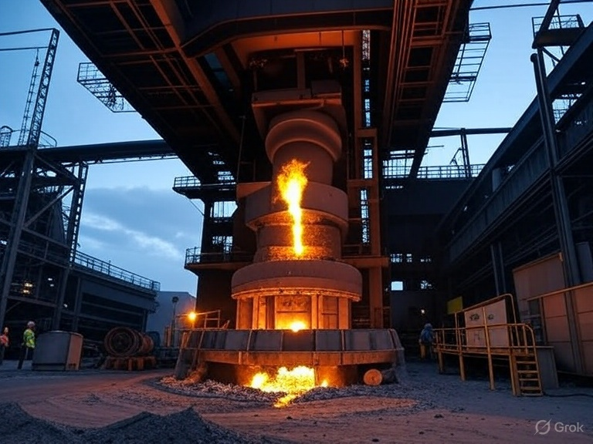
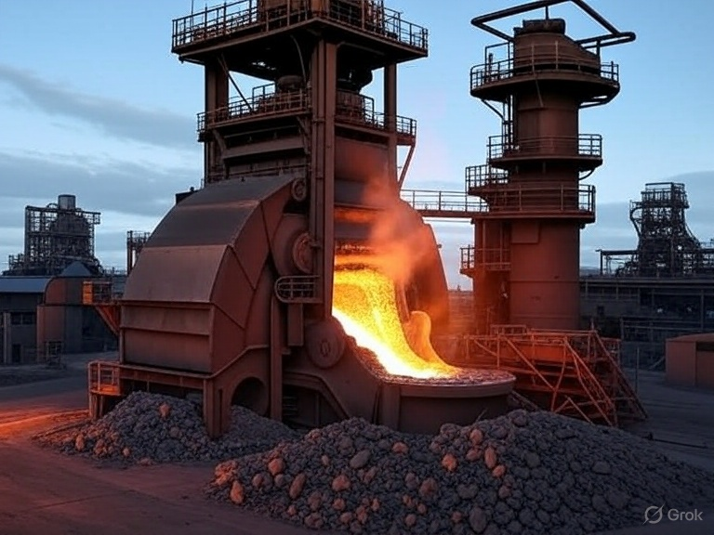
Operational sectors of Jindal Steel
Manufacturing
Mining
Energy
Jindal Steel is a leader in manufacturing high-quality steel products.
The company focuses on innovation and efficiency to meet market demands.
The mining division is crucial for sourcing raw material for steel production.
Jindal Steel operates several mines to ensure a steady supply of iron ore and coal
Energy production is vital to Jindal Steel’s operations.
The company invests in sustainable energy solutions to power its facilities

Slide 8
Operational sectors of Jindal Steel
Logistics
Infrastructure
Efficient logistics are essential for timely product delivery
Jindal steel has a robust logistics network to support its operation
Jindal steel plays a significant role in infrastructure development
The company contributes to building the framework for future growth

Slide 9
Comparison of domestic vs international operations
Domestic Market Share
International Revenue Contribution
Jindal steel holds a significant share of the domestic market , benefiting from established relationships with local suppliers and customers.
The company has a strong brand presence in India, which contributes to its competitive advantage.
Domestic operations are supported by a robust distribution network , ensuring timely delivery and service.
Overall, the domestic market remains a primary revenue source for Jindal steel.
International operations contribute a growing portion of Jindal Steel’s overall revenue, reflecting its global expansion strategy
The company has successfully entered various international markets, diversifying its revenue streams
However, international operations face challenges such as fluctuating exchange rates and varying regulatory environments.
Despite these challenges, the international segment is crucial for long-term growth and sustainability

Slide 10
Milestones of Jindal Steel’s Growth
Project launch
New Facility
Strategic
Partnership
Innovation Award
Market Expansion
Jindal Steel launched its flagship project in 2005
A new manufacturing facility was inaugurated in 2010
The company expanded its market reach to Southeast Asia in 2015
The company received the Innovation Award in 2021 for its sustainable practices
In 2018, Jindal Steel formed a strategic partnership with a leading global firm.

Slide 11
SWOT Analysis of Jindal steel
s
W
Strength
Weaknesses
Jindal Steel holds a strong position in the steel industry, being one of the largest producers in India
Rising raw material costs have been a significant challenge for Jindal steel.
o
T
Opportunities
Threats
There are substantial opportunities for Jindal Steel to expand its market share in emerging economies
Jindal steel is subject to stringent environment regulations that could impact operations

Slide 12
PESTEL Analysis on Jindal steel
P
E
S
T
E
L
Political stability in India supports a favorable business environment for Jindal steel.
The demand for steel is increasing due to infrastructure development in India.
Recent regulatory changes aim to enhance sustainability in the steel industry.
Innovations in steel production technology are improving efficiency and reducing costs.
Jindal steel is focusing on reducing its carbon footprint through sustainable practices.
Adhering to legal standards is essential for Jindal steel to avoid penalities

Slide 13
Hierarchy of Jindal Steel’s Business Strategy
Foundational Goals
We build a strong culture
Operational Efficiency
We improve production processes
Market Expansion
We explore new markets
Innovation Focus
We drive technological advancements
Sustainability initiatives
We commit to eco-friendly practices

Slide 14
Step-by-Step Process of Steel Manufacturing
Raw Materials
Production Process
Quality Control
Final products

Slide 15
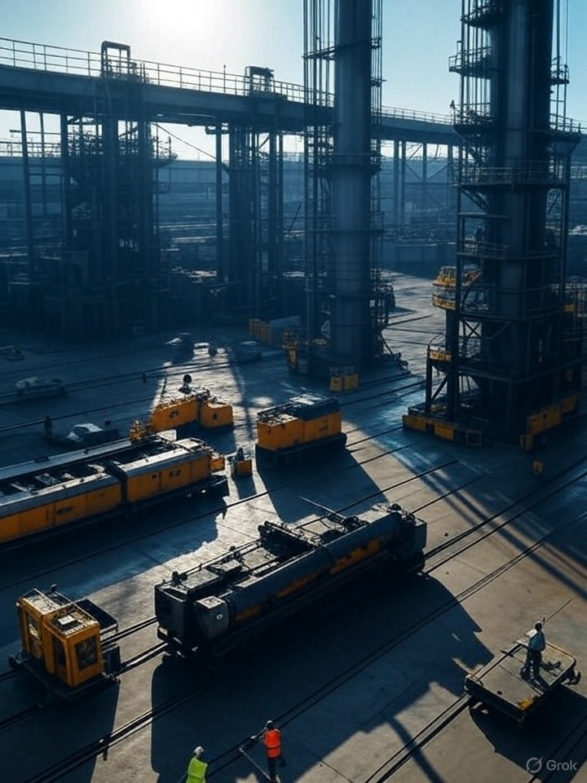
The primary raw materials for steel for steel manufacturing are iron ore, coal and limestone.
These materials are sourced from various suppliers to ensure quality and consistency
The production process begins with the smelting of iron ore in a blast furnace
This process convers iron ore into molten iron, which is then refined to produce steel.
Quality control is implemented at every stage of the manufacturing process
The final product include various steel grades and forms, such as sheets, bars and coils

Slide 16
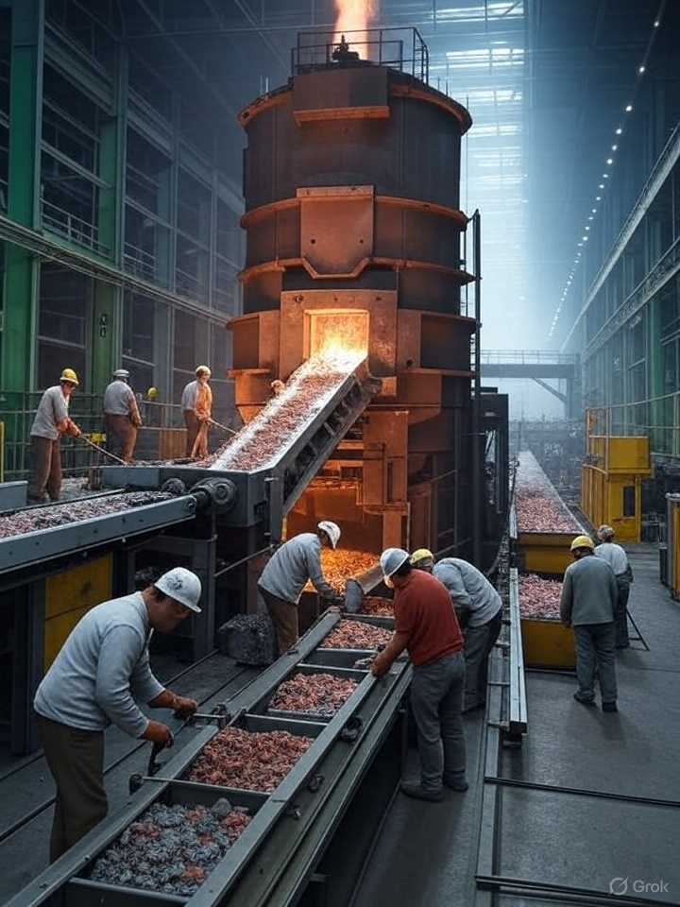
The company’s revenue has grown by 15% reflecting strong market demand
Supply chain disruptions have caused delays in production schedules
The company is focusing on sustainable practices to reduce its carbon footprint
The construction sector’s recovery is expected to drive steel consumption
The company plans to expand its product line to include more eco friendly options

Slide 17
Jindal Steel’s Performance and Future Outlook
Performance
Key Challenges
Strategic Initiatives
Jindal Steel has shown a steady increase in production capacity over the past year
The company faces rising raw material costs that impact profit margins.
Jindal Steel is investing in technology to enhance operational efficiency
Market Trends
Future Projections
There is a growing demand for green steel in the global market
Jindal steel aims to increase tis market share by 10% in the next fiscal year

Slide 18
Profitability funnel : From revenue to Net income
1
Jindal Steel’s primary revenue source is steel production
2
Key costs significantly impact profitability
3
Net income results form subtracting total costs from revenue

Slide 19
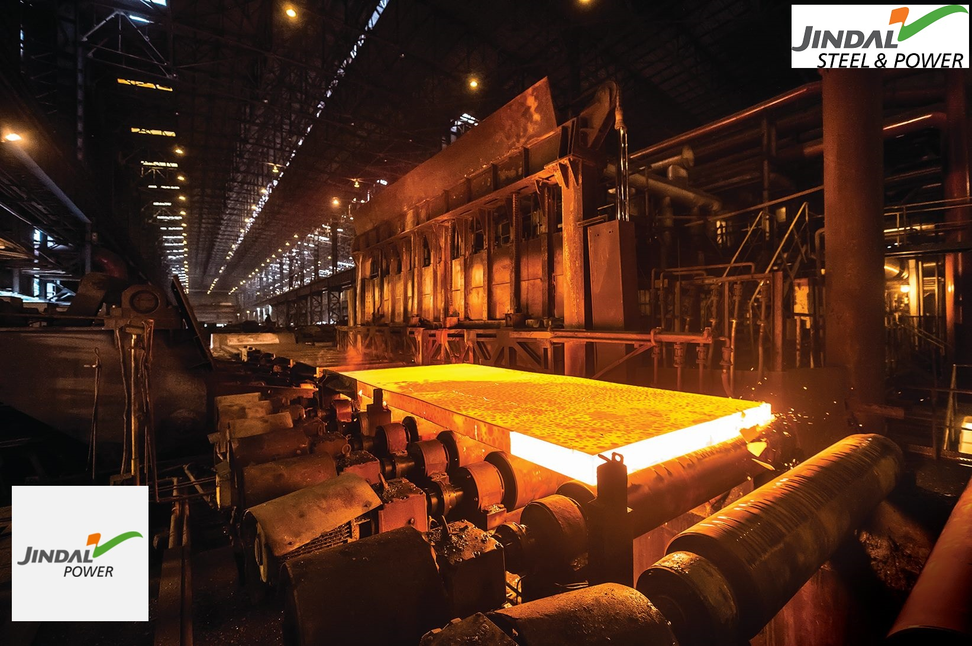
Emission Control:
Pulse jet & invertible bag filters
Electrostatic Precipitators in DRI kilns
Water Management:
Wastewater reused (coke oven, sinter plants)
Blast Furnace water recycled
Slag Use:2 MTPA slag & fly ash cement plant Raigarh

Slide 20
Recent developments
West Bengal:
₹100 crore investment (steel pipes)
Target: 5,000 MT/month, ₹315 crore revenue (FY26)
Andhra Pradesh:
Integrated Steel Plant (Gudur)
₹10,000 crore, 860 acres
MOU: March 3, 2023

Slide 21
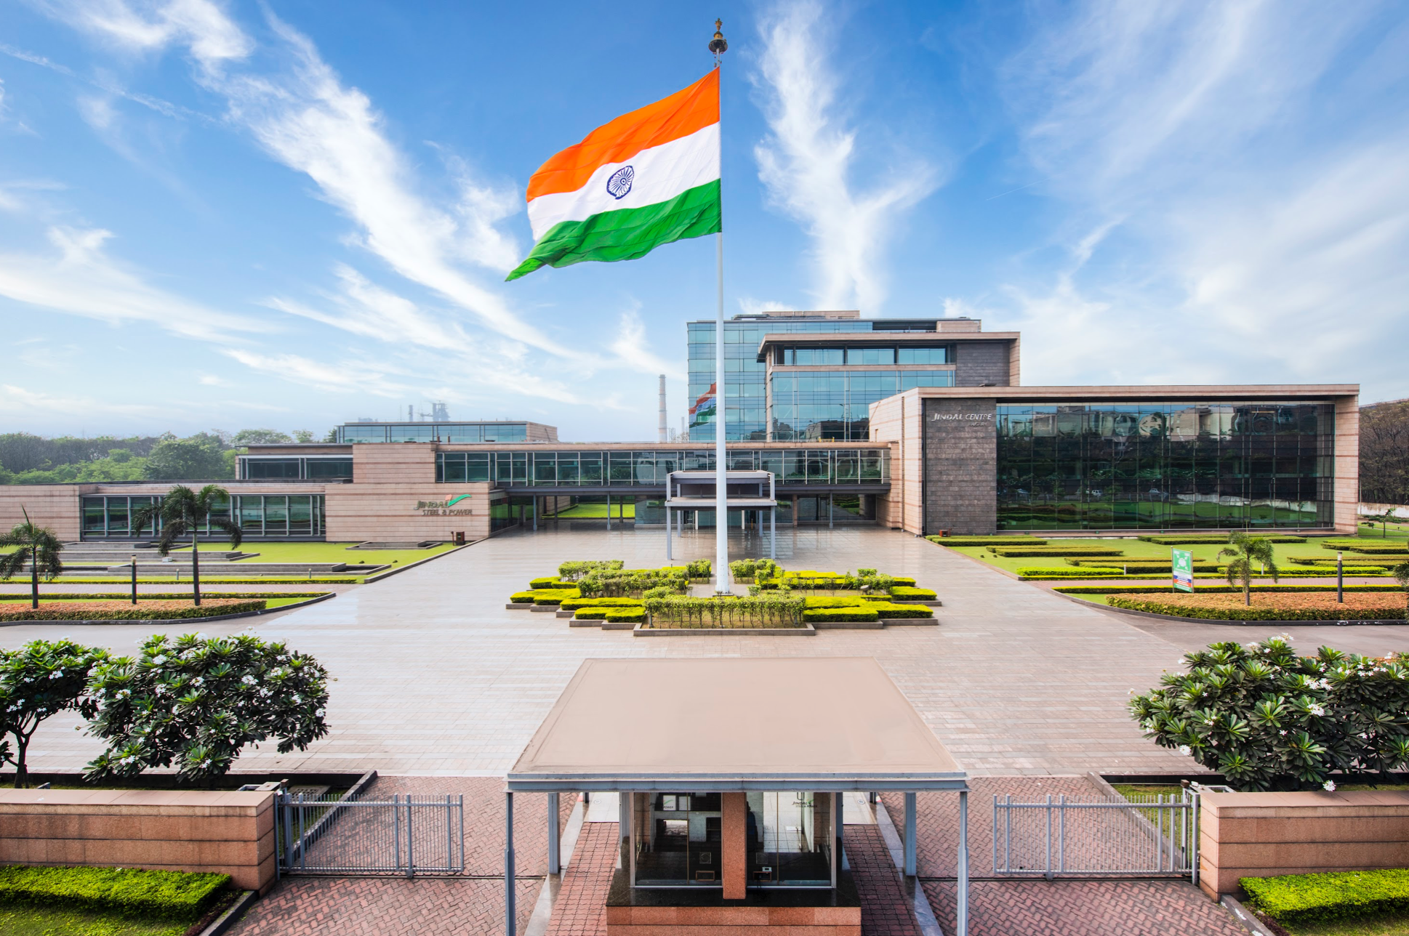
Plant in Raigarh
Situated in Raigarh, Chhattisgarh, India.
One of the largest steel plants in India, part of JSPL’s 10.0 MTPA steel production capacity in the country.
Spread over a large industrial area with extensive infrastructure for steel production and power generation.

Slide 22
Located in Raipur (near Raigarh), spanning 162,000 sq. meters.
Facilities include:
Steel foundry for casting heavy components.
CNC machine shop for precision machining.
Fabrication and assembly shops for equipment manufacturing.
Heat treatment furnaces for hardening steel components.
Produces industrial equipment like pressure vessels, cranes, and steel castings for steel, power, and mining industries.

Slide 23
The Raigarh plant is a cornerstone of JSPL’s operations, contributing significantly to its steel production capacity.
It supports JSPL’s backward integration strategy by utilizing captive iron ore and coal from nearby mines.
The plant’s rail and beam production capabilities make it a key supplier for infrastructure projects, including Indian Railways.

Slide 24
Committed to cutting emissions for a healthier planet
Investing in solar and wind power to fuel operations
Active water conservation and waste recycling programs.
Targeting carbon neutrality by mid-century with circular economy.

Slide 25
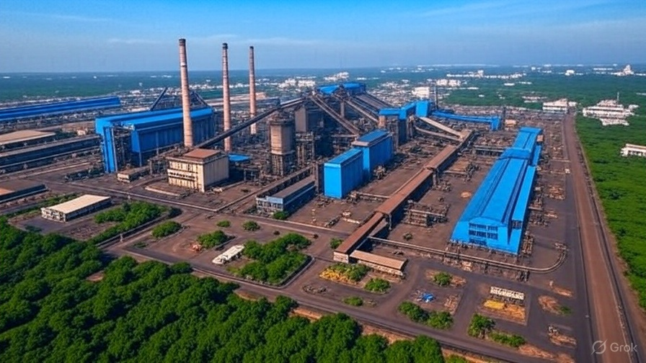
Wastewater Recycling:
In the Raigarh plant, wastewater from coke oven quenching is settled in tanks and reused in other processes, reducing freshwater consumption.
Blow-down water from sinter plants is reused in nodulizing , and Blast Furnace wastewater is treated and recycled back into the system.
Zero Liquid Discharge (ZLD):
JSPL aims for ZLD across its facilities, ensuring no industrial wastewater is discharged into the environment. Treatment systems are in place to achieve this goal.

Slide 26
Waste Heat Recovery:
Captive power plants, including those at Raigarh, utilize waste heat recovery systems to generate electricity from the heat produced during steelmaking, reducing reliance on external power sources.
Renewable Energy Integration:
JSPL is exploring renewable energy sources to power its operations. While specific details on solar or wind integration at Raigarh are not fully disclosed, the company has a broader commitment to increasing renewable energy usage across its plants.

Slide 27
Certifications and Goals:
JSPL aligns its operations with global sustainability standards, such as those set by the World Steel Association’s Climate Action Programme.
The company has set internal targets to reduce carbon emissions intensity, though specific numerical goals for Raigarh are not publicly detailed as of May 19, 2025.
Reporting and Transparency:
JSPL publishes sustainability reports detailing its environmental performance, including energy use, emissions, and waste management metrics, ensuring accountability.

Slide 28
Greenery Around Plants
Land Restoration
Reporting and Transparency

Slide 30
Shaping the future of Steel
Infrastructure Growtho
Innovative Leadership
Value Creation
Responsible Production

Slide 31
By Dasari L A K Pavan Kumar ID No: 2400090291

